Slide 1
Stacks and Queues
Akash Hegde
Seventh Sense Talent Solutions
Vivekananda Institute of Technology
25 March 2021

Slide 2
Introduction to Stack
A stack is an Abstract Data Type (ADT), commonly used in most programming languages.
It is named stack as it behaves like a real-world stack, for example – a deck of cards or a pile of plates.
A real-world stack allows operations at one end only.
For example, we can place or remove a card or plate from the top of the stack only.
Likewise, Stack ADT allows all data operations at one end only.
At any given time, we can only access the top element of a stack.

Slide 3
Introduction to Stack
This feature makes it LIFO data structure.
LIFO stands for Last-in-first-out.
Here, the element which is placed (inserted or added) last, is accessed first.
In stack terminology, insertion operation is called PUSH operation and removal operation is called POP operation.

Slide 4
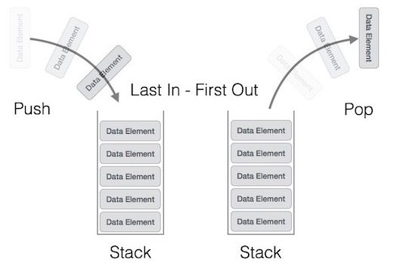
Stack Representation
The following diagram depicts a stack and its operations −

Slide 5
Stack Operations
Stack operations may involve initializing the stack, using it and then de-initializing it.
Apart from these basic operations, a stack is used for the following two primary operations −
push() − Pushing (storing) an element on the stack.
pop() − Removing (accessing) an element from the stack.

Slide 6
Stack Operations
To use a stack efficiently, we need to check the status of stack as well.
For the same purpose, the following functionality is added to stacks −
peek() − get the top data element of the stack, without removing it.
isFull() − check if stack is full.
isEmpty() − check if stack is empty.

Slide 7
Stack Operations
At all times, we maintain a pointer to the last pushed data on the stack.
As this pointer always represents the top of the stack, hence named top.
The top pointer provides top value of the stack without actually removing it.

Slide 8
Stack Operations – peek()
Algorithm of peek() function − begin procedure peek return stack[top] end procedure
Implementation of peek() function − int peek() { return stack[top]; }

Slide 9
Stack Operations – isfull()
Algorithm of isfull() function − begin procedure isfull if top equals to MAXSIZE return true else return false endif end procedure
Implementation of isfull() function − bool isfull() { if(top == MAXSIZE) return true; else return false; }

Slide 10
Stack Operations – isempty()
Algorithm of isempty() function − begin procedure isempty if top less than 1 return true else return false endif end procedure
Implementation of isempty() function - bool isempty() { if(top == -1) return true; else return false; }

Slide 11
Stack Operations – push()
The process of putting a new data element onto stack is known as a Push Operation.
Push operation involves a series of steps −
Step 1 − Checks if the stack is full.
Step 2 − If the stack is full, produces an error and exit.
Step 3 − If the stack is not full, increments top to point next empty space.
Step 4 − Adds data element to the stack location, where top is pointing.
Step 5 − Returns success.

Slide 12
Stack Operations – push()
Algorithm for PUSH Operation begin procedure push: stack, data if stack is full return null endif top ← top + 1 stack[top] ← data end procedure
Implementation of push() − void push(int data) { if(!isFull()) { top = top + 1; stack[top] = data; } else { printf("Could not insert data, Stack is full.\n"); } }

Slide 13
Stack Operations – pop()
Accessing the content while removing it from the stack, is known as a Pop Operation.
In an array implementation of pop() operation, the data element is not actually removed, instead top is decremented to a lower position in the stack to point to the next value.
But in linked-list implementation, pop() actually removes data element and deallocates memory space.
A Pop operation may involve the following steps −
Step 1 − Checks if the stack is empty.
Step 2 − If the stack is empty, produces an error and exit.
Step 3 − If the stack is not empty, accesses the data element at which top is pointing.
Step 4 − Decreases the value of top by 1.
Step 5 − Returns success.

Slide 14
Stack Operations – pop()
Algorithm for Pop Operation begin procedure pop: stack if stack is empty return null endif data ← stack[top] top ← top - 1 return data end procedure
Implementation of pop() − int pop(int data) { if(!isempty()) { data = stack[top]; top = top - 1; return data; } else { printf("Could not retrieve data, Stack is empty.\n"); } }

Slide 15
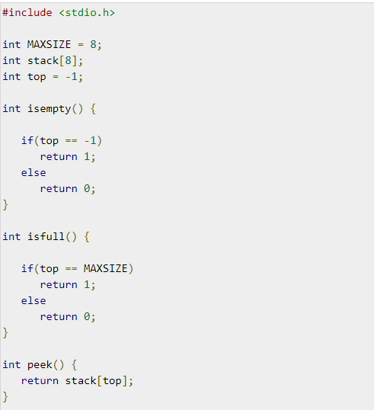
Stack Implementation
Program to implement stack (part 1) –

Slide 16
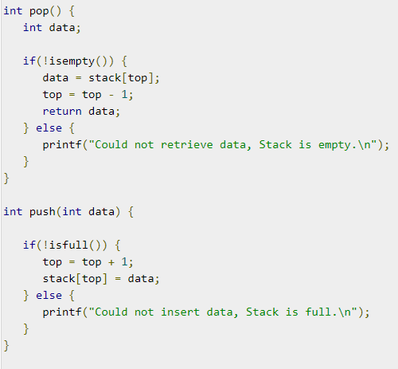
Stack Implementation
Program to implement stack (part 2) –

Slide 17
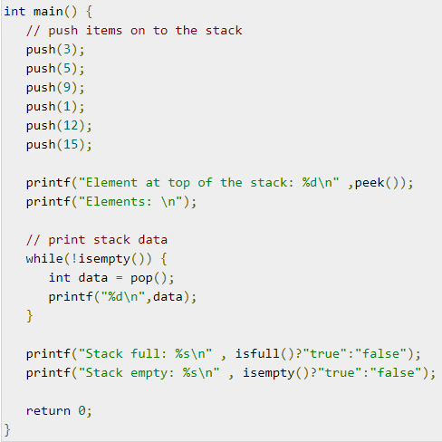
Stack Implementation
Program to implement stack (part 3) –

Slide 18
Introduction to Queue
Queue is an abstract data structure, somewhat similar to Stacks.
Unlike stacks, a queue is open at both its ends.
One end is always used to insert data (enqueue) and the other is used to remove data (dequeue).
Queue follows First-In-First-Out methodology, i.e., the data item stored first will be accessed first.
A real-world example of queue can be a single-lane one-way road, where the vehicle enters first, exits first. More real-world examples can be seen as queues at the ticket windows and bus-stops.

Slide 19
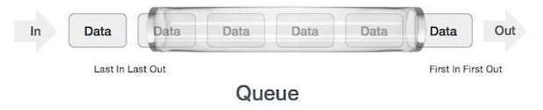
Queue Representation
The following diagram gives queue representation as data structure −

Slide 20
Queue Operations
Queue operations may involve initializing or defining the queue, utilizing it, and then completely erasing it from the memory.
Here we shall try to understand the basic operations associated with queues −
enqueue() − add (store) an item to the queue.
dequeue() − remove (access) an item from the queue.

Slide 21
Queue Operations
Few more functions are required to make the above-mentioned queue operation efficient. These are −
peek() − Gets the element at the front of the queue without removing it.
isfull() − Checks if the queue is full.
isempty() − Checks if the queue is empty.
In queue, we always dequeue (or access) data, pointed by front pointer and while enqueuing (or storing) data in the queue we take help of rear pointer.

Slide 22
Queue Operations – peek()
This function helps to see the data at the front of the queue.
The algorithm of peek() function is as follows − begin procedure peek return queue[front] end procedure
Implementation of peek() function - int peek() { return queue[front]; }

Slide 23
Queue Operations – isfull()
Algorithm: begin procedure isfull if rear equals to MAXSIZE return true else return false endif end procedure
Implementation of isfull() function − bool isfull() { if(rear == MAXSIZE - 1) return true; else return false; }

Slide 24
Queue Operations – isempty()
Algorithm: begin procedure isempty if front is < MIN OR front is > rear return true else return false endif end procedure
Implementation: bool isempty() { if(front < 0 || front > rear) return true; else return false; }

Slide 25
Queue Operations – enqueue()
Queues maintain two data pointers, front and rear.
Therefore, its operations are comparatively difficult to implement than that of stacks.
The following steps should be taken to enqueue (insert) data into a queue −
Step 1 − Check if the queue is full.
Step 2 − If the queue is full, produce overflow error and exit.
Step 3 − If the queue is not full, increment rear pointer to point the next empty space.
Step 4 − Add data element to the queue location, where the rear is pointing.
Step 5 − return success.

Slide 26
Queue Operations – enqueue()
Algorithm for enqueue operation procedure enqueue(data) if queue is full return overflow endif rear ← rear + 1 queue[rear] ← data return true end procedure
Implementation of enqueue() - int enqueue(int data){ if(isfull()) return 0; rear = rear + 1; queue[rear] = data; return 1; }

Slide 27
Queue Operations – dequeue()
Dequeue Operation
Accessing data from the queue is a process of two tasks − access the data where front is pointing and remove the data after access.
The following steps are taken to perform dequeue operation −
Step 1 − Check if the queue is empty.
Step 2 − If the queue is empty, produce underflow error and exit.
Step 3 − If the queue is not empty, access the data where front is pointing.
Step 4 − Increment front pointer to point to the next available data element.
Step 5 − Return success.

Slide 28
Queue Operations – dequeue()
Algorithm for dequeue operation procedure dequeue if queue is empty return underflow end if data = queue[front] front ← front + 1 return true end procedure
Implementation of dequeue() - int dequeue() { if(isempty()) return 0; int data = queue[front]; front = front + 1; return data; }

Slide 29
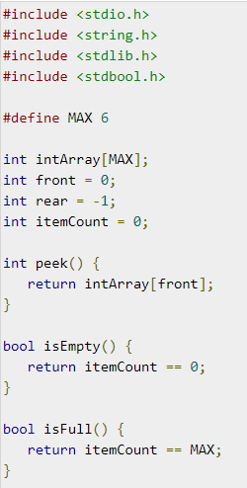
Queue Implementation
Program to implement queue (part 1) –

Slide 30
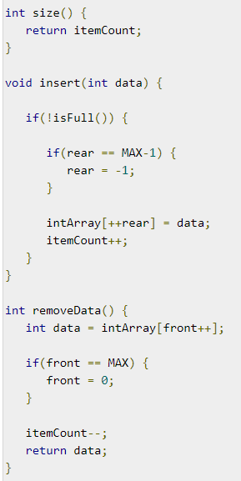
Queue Implementation
Program to implement queue (part 2) –

Slide 31
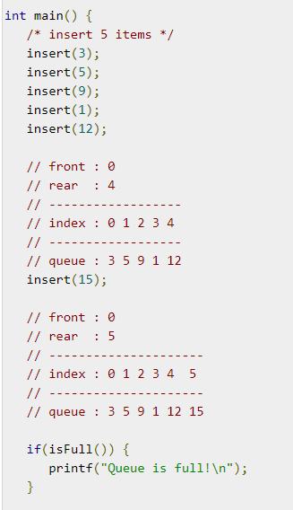
Queue Implementation
Program to implement queue (part 3) –

Slide 32
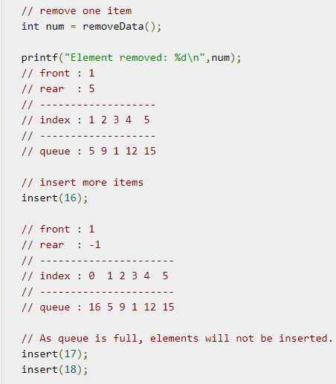
Queue Implementation
Program to implement queue (part 4) –

Slide 33
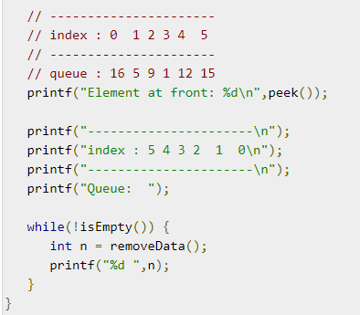
Queue Implementation
Program to implement queue (part 5) –

Slide 34
Thank you!

